Slide 1
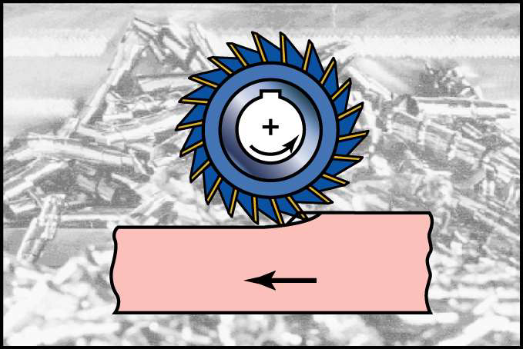
Milling Machine and Milling Processes

Slide 2
Milling is a metal cutting operation in which the excess material from the work piece is removed by rotating multipoint cutting tool called milling cutter.
A milling machine is a machine tool that removes metal as the work is fed against a rotating multipoint cutter. The milling cutter rotates at high speed and it removes metal at a very fast rate with the help of multiple cutting edges.
One or more number of cutters can be mounted simultaneously on the milling machine. This is the reason that a milling machine finds wide application in production work.

Slide 3
As the workpiece moves against the cutting edges of milling cutter, metal is removed in form of chips.
Machined surface is formed in one or more passes of the work.
The work to be machined is held in a vice/ a rotary table/ a three jaw chuck/ an index head/ in a special fixture or bolted to machine table.
In many applications, due to its higher production rate and accuracy, milling machine has even replaced shapers and slotters.

Slide 4
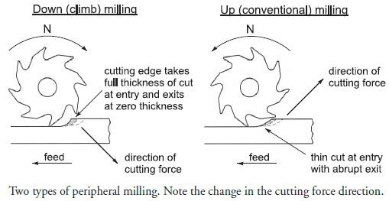
Milling Methods
Two basic methods of milling
Down (climb) milling, when the cutter rotation is in the same direction as the motion of the work piece being fed.
Up (conventional) milling, in which the work piece is moving towards the cutter, opposing the cutter direction of rotation.

Slide 5
Comparison of Up and Down Milling
Down milling, the cutting force is directed into the work table, which allows thinner work parts to be machined and better surface finish is obtained.
Up milling, the cutting force tends to lift the work piece. The work conditions for the cutter are more favorable because the cutter does not start to cut when it makes contact with workpiece.

Slide 6
Types of Milling Machine
The milling machine may be classified in several forms, but the choice of any particular machine is determined primarily by the size of the workpiece.
The Milling machine is classified as:
1. Column and knee type milling machines (mostly used)
2. Planer milling machine
3. Fixed-bed type milling machine
4. Special types of milling machines

Slide 7
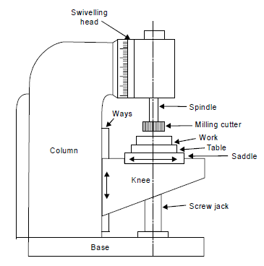
COLUMN AND KNEE TYPE
It is the most commonly used milling machine used for general shop work.
The table is mounted on the knee which in turn is mounted on the vertical slides of the main column.
The knee is vertically adjustable on the column so that the table can be moved up and down to accommodate work of various heights.

Slide 8
CLASSIFIACTION OF COLUMN & KNEE TYPE MILLING MACHINE :
(a) Hand milling m/c.
(b) Horizontal milling m/c.
(c) Universal milling m/c.
(d) Vertical milling m/c.

Slide 9
Horizontal Milling Machine
The horizontal milling machine has a spindle that is parallel to the shop floor and an overarm that extends over the workpiece.
The overarm supports the arbor, which holds the milling cutter.
On the horizontal mill, the arbor is the component that rotates the milling cutter.

Slide 10
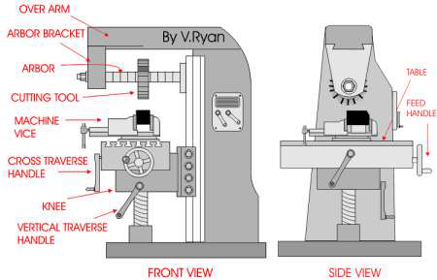

Slide 11
Vertical Milling Machine
Spindle is vertical or perpendicular to the work table.
It has all the movements of the table for proper setting and feeding the work.
Spindle head may be swiveled at an angle, permitting the milling cutter mounted on the spindle to work on angular surfaces.
In some machines, spindle can also be adjusted up or down relative to the work.
Adopted for machining grooves, slots and flat surfaces.

Slide 12
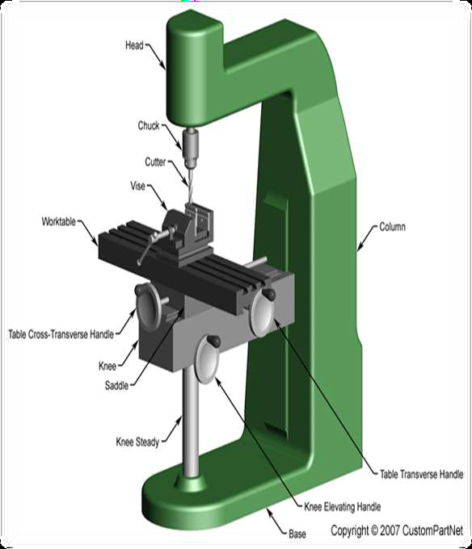

Slide 13
Milling operations :
Plain or slab milling
Face milling
End milling
Side milling
Slot milling
Form milling
Straddle milling
Gang milling

Slide 14
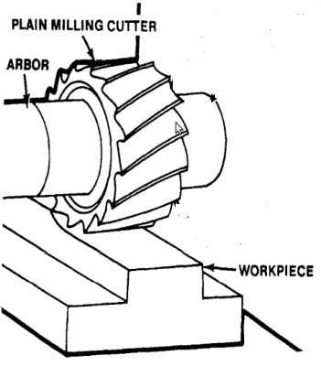
PLAIN/SURFACE/ SLAB MILLING
Process to get the flat surface on the work piece in which the cutter axis and work piece axis are parallel. The primary motion is the rotation of the cutter. The feed is imparted to the workpiece.
Cutter: Plain milling cutter.
Machine:Horizontal Milling m/c.

Slide 15
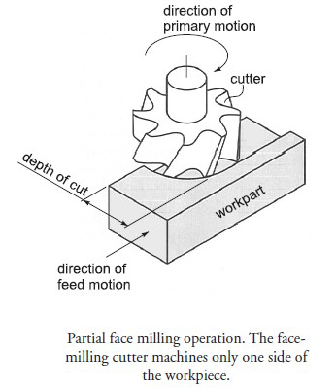
FACE MILLING
Operation carried out for producing a flat surface, which is perpendicular to the axis of rotating cutter.
Cutter: Face milling cutter.
Machine: Vertical Milling Machine

Slide 16
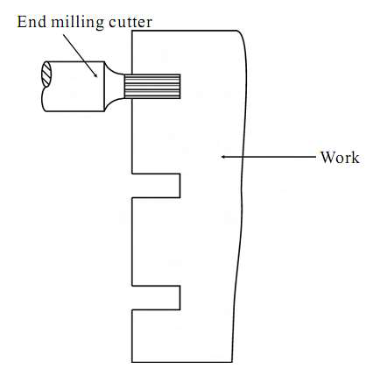
END MILLING
Operation performed for producing flat surfaces, key slots, grooves or finishing the edges of the work piece.
Cutter: End milling cutter.
Machine: Vertical Milling Machine

Slide 17
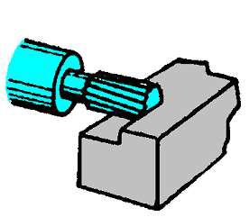
SIDE MILLING
Operation performed for producing flat surfaces, slots, grooves or finishing the edges of the work piece.
Cutter: End milling cutter.
Machine: Horizontal Milling Machine

Slide 18
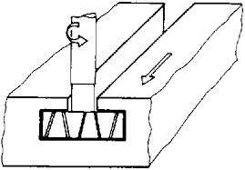
SLOT MILLING
Operation of producing slots like T-slots, plain slots etc.,
Cutter: End milling cutter, T-slot cutter, side milling cutter
Machine: Vertical Milling Machine

Slide 19
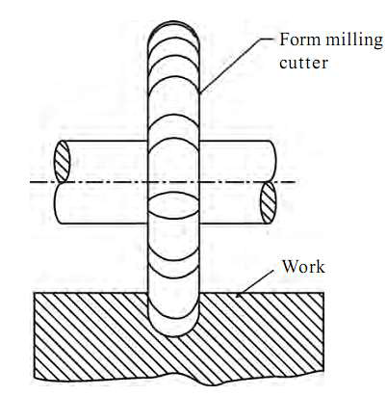
FORM MILLING
Operation of producing all types of angular cuts like V-notches and grooves, serrations and angular surfaces.
Cutter: Double angle cutter.
Machine: Horizontal Milling Machine

Slide 20
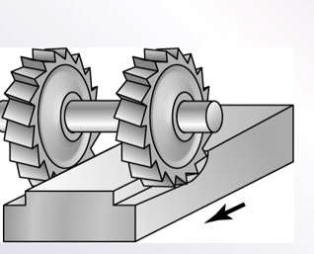
STRADDLE MILLING
Operation of machining two parallel surfaces simultaneously on a workpiece.
Cutter: 2 or more side & face milling cutters
Machine: Horizontal Milling Machine

Slide 21
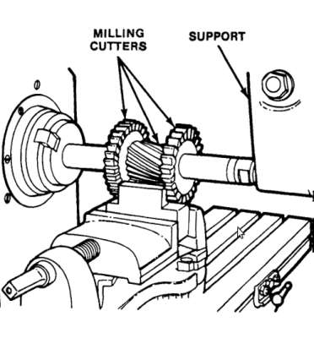
GANG MILLING
Process to get different profiles on the work piece simultaneously with two or more cutters at one stretch.
Cutter: Different cutters as required.
Machine: Horizontal Milling Machine

